Slide 1
Disney Wait Time Analysis: Is Lightning Lane Worth It?
Data Analysis Project

Slide 2
Business Problem
Disney guests often face long wait times for popular rides
Lightning Lane is a paid option to skip lines
It is unclear when and where Lightning Lane provides the most value
Key Question:
Does Lightning Lane significantly reduce wait times, and when is it most valuable?

Slide 3
Data Overview
Public dataset of Disney World ride wait times
Includes multiple rides across different parks
Data includes:
Date and time of ride
Posted and actual wait times
Over 270,000+ observations analyzed

Slide 4
Data Preparation
Combined multiple ride datasets into one dataset
Created a unified wait_time column
Converted datetime fields for time-based analysis
Removed:
Negative wait times (invalid data)
Missing values
Ensured accurate and reliable analysis

Slide 5
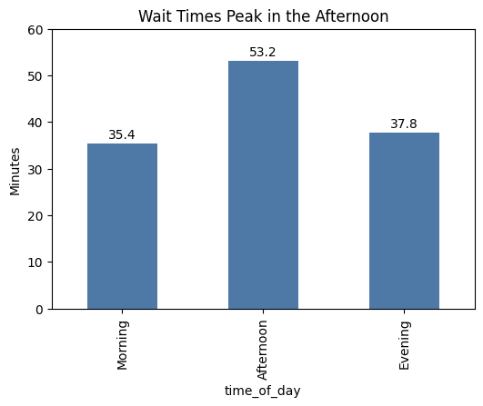
Wait Times Peak in the Afternoon
Key Points:
Afternoon: ~53 minutes (highest)
Morning: ~35 minutes (lowest)
Evening: ~38 minutes
Insight:
Peak demand occurs in the afternoon

Slide 6
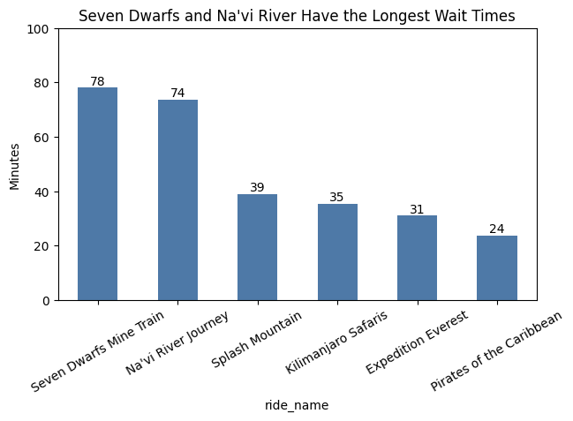
Certain Rides Drive the Longest Waits
Key Points:
Seven Dwarfs Mine Train (~78 min)
Na’vi River Journey (~74 min)
Other rides are significantly lower (24–39 min)
Insight:
A small number of rides account for the longest wait times

Slide 7
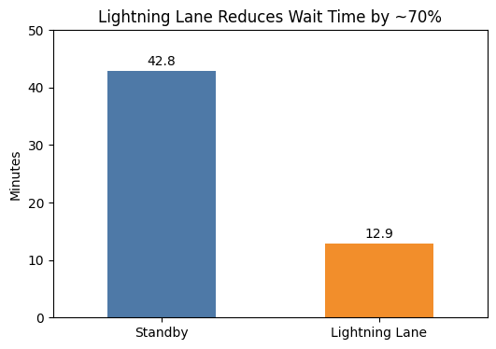
Lightning Lane Significantly Reduces Wait Time
Key Points:
Average standby wait: ~43 minutes
Estimated Lightning Lane wait: ~13 minutes
~30 minutes saved per ride
Insight:
Lightning Lane reduces wait times by ~70%

Slide 8
When is Lightning Lane Most Valuable?
During afternoon peak hours
For high-demand rides:
Seven Dwarfs Mine Train
Na’vi River Journey
Conclusion:
Lightning Lane provides the greatest benefit during peak demand periods

Slide 9
Recommendations
For Guests:
Use Lightning Lane for high-demand rides
Prioritize usage in the afternoon
Ride lower-demand attractions without it
For Disney:
Consider dynamic pricing based on demand
Optimize ride capacity for high-wait attractions

Slide 10
Key Takeaways
Wait times are highest in the afternoon
A few rides drive the majority of long waits
Lightning Lane significantly reduces wait times
Best Strategy:
Use Lightning Lane selectively for peak times and high-demand rides

Slide 11
Tools & Skills Demonstrated
Python (Pandas, Matplotlib)
Data Cleaning & Transformation
Exploratory Data Analysis
Data Visualization
Insight Communication

Slide 12
Data Source
Disney World Wait Time Dataset
Public dataset (Touring Plans / Kaggle / GitHub)
Data cleaned and transformed for analysis

